Slide 1



Issues in device development education in collaboration with medical institutions
National Institute of Technology (KOSEN),
NIIHAMA College
Takashi YOSHIKAWA, Nozomu IMANISHI
MATSUYAMA REHABILITATION HOSPITAL
Yuichi SUZUKI
16th International Symposium on Advances in Technology Education
September 12-15, 2023, Matsue City, Japan
Notes:
Thank you chairman. I talk about Issues
in device development education in collaboration
with medical institutions.
I speak English very bad. so, please listen at narration.

Slide 2

Issues in Mechanical Engineering Education for Hands-on Learning
Due to constraints related to physical space, finances, and equipment, problem-solving often remains confined to conceptual ideas.
Proposed solutions tend to be limited to 3D modeling.
Developing concrete problem-solving solutions, such as applications through programming, is challenging in the field of mechanical engineering.
Notes:
In recent years, we have the following issues in Mechanical Engineering Education for Hands-on Learning.
Example, Due to constraints related to physical space, finances, and equipment, problem-solving often remains confined to conceptual ideas.
・Proposed solutions tend to be limited to 3D modeling.
・Developing concrete problem-solving solutions, such as applications through programming, is challenging in the field of mechanical engineering.

Slide 3
Increasing students with No Experience in Manufacturing
Difficulty in Transforming Ideas into Reality.
Defining Manufacturing as Goal-Oriented Problem Solving.
Namely, Distinguishing Manufacturing from Craftsmanship
Notes:
Young people in Japan are enthusiastic about playing online games at home, and the number of students who have little experience in making things is increasing.
As a negative effect, the number of students who find it difficult to embody their ideas is increasing.
Here, manufacturing is defined as problem solving with a clear purpose and a set goal (specification).
In other words, manufacturing and crafting are different.

Slide 4
Issues in Medical-Engineering Collaboration
Three user perspectives existing
【Care Recipients】・【Caregivers】・【Purchasers】
Divergent Needs（antinomy）
【Care recipients】 prioritize comfort and functionality, which may require more complex and expensive solutions.
【Caregivers】 aim for user-friendly designs and error prevention, which can be at odds with complex features.
【Purchasers】 focus on cost-effectiveness and space-saving, which may lead to compromises on comfort and functionality.
These are contradictory items
Notes:
There are additional problems in manufacturing through medical-engineering collaboration.
When creating products, we must consider the following three user positions.
Care Recipients ・Caregivers ・Purchasers
The needs of these three parties are often contradictory.
Care recipients prioritize comfort and functionality, which may require more complex and expensive solutions.
Other hand, Caregivers aim for user-friendly designs and error prevention, which can be at odds with complex features.
And then, Purchasers focus on cost-effectiveness and space-saving, which may lead to compromises on comfort and functionality.
These are contradictory items.

Slide 5
Key Considerations in Medical-Engineering Collaboration and Manufacturing
Seeking Compromise through Discussion
Meeting or exceeding the minimum requirements for each stakeholder's needs is imperative. If any one of these requirements falls short, the product may not find acceptance or use.
To sustain a "try and error" approach, it is crucial to have continuous feedback from the field and clear explanations of technical challenges from the manufacturing side.
Notes:
We think that Key Considerations in Medical-Engineering Collaboration and Manufacturing as following.
Seeking Compromise through Discussion.
Meeting or exceeding the minimum requirements for each stakeholder's needs is imperative. If any one of these requirements falls short, the product may not find acceptance or use.
To sustain a "try and error" approach, it is crucial to have continuous feedback from the field and clear explanations of technical challenges from the manufacturing side.

Slide 6
Assistive Technology(AT) Special Curriculum
STEP1：Gain knowledge about the characteristics of care recipients and individuals in need of assistance.
STEP2：Understand the needs of the medical site, propose multiple solutions, and refine them based on feedback from the field.
STEP3：Materialize the refined ideas into tangible forms or prototypes. Create prototypes or products in a state where they are ready for practical testing and use.
STEP4：Collect feedback and make further improvements through field trials.
STEP5：Acquire knowledge related to evaluation methods, such as sample sizes and significance testing, to assess the effectiveness of the developed solutions.
Notes:
Therefore, starting in 2019, we established a special curriculum to provide opportunities for assistive technology.
They have 5 steps.
STEP1：Gain knowledge about the characteristics of care recipients and individuals in need of assistance .
STEP2：Understand the needs of the medical site, propose multiple solutions, and refine them based on feedback from the field.
STEP3：Materialize the refined ideas into tangible forms or prototypes. Create prototypes or products in a state where they are ready for practical testing and use.
STEP4：Collect feedback and make further improvements through field trials.
STEP5：Acquire knowledge related to evaluation methods, such as sample sizes and significance testing, to assess the effectiveness of the developed solutions.

Slide 7
AT Special Curriculum
The course consists in 6 Units & 5 classes
1unit=90[min]x15times
(1): Introduction to Assistive Technology: IAT,
(2): Practice in Assistive Design: PAD,
(3): Practice in Clinical Equipment development: PCED,
(4): Assistive Technology and Co-op: CPAT,
(5): Introduction to Medical Welfare Technology: IMWT.
Notes:
A-T Special Curriculum consist in 6 units and 5 classes.
These name of classes are following.
(1): Introduction to Assistive Technology: IAT,
(2): Practice in Assistive Design: PAD,
(3): Practice in Clinical Equipment development: PCED,
(4): Assistive Technology and Co-op: CPAT,
(5): Introduction to Medical Welfare Technology: IMWT.

Slide 8
IAT：Introduction to Assistive Technology
(1) Regarding welfare devices, there are cases where the needs to be addressed may conflict among the purchaser /manager, operator/ caregiver, and the individuals /patients who have directly involved physical contact. Understanding and being able to explain what constitutes an "usable product" in light of these perspectives and developing products accordingly.
(2) Acquiring knowledge of human characteristics (ergonomics) and understanding and explaining their applicability to future development and other areas.
(3) Understanding and explaining how the shape of objects and the work environment can affect the human body differently.
Notes:
These are three goals for this class:
(1) Regarding welfare devices, there are cases where the needs to be addressed may conflict among the purchaser (manager), operator (caregiver), and the individuals (patients) who have directly involved physical contact. Understanding and being able to explain what constitutes an "usable product" in light of these perspectives and developing products accordingly. (2) Acquiring knowledge of human characteristics (ergonomics) and understanding and explaining their applicability to future development and other areas.
(3) Understanding and explaining how the shape of objects and the work environment can affect the human body differently.

Slide 9
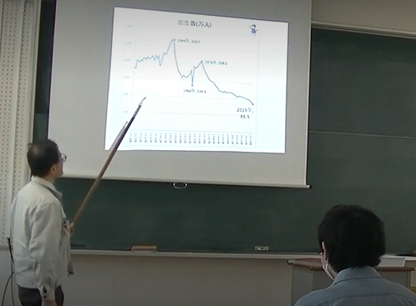
IAT

Slide 10
PAD：Practice in Assistive Design
In the PAD course, students collaborate with medical institutions to generate ideas and receive feedback from the field in response to their needs.
(1) Understanding the engineering process and being able to generate problem-solving proposals that incorporate fail-safe and foolproof considerations.
(2) Delivering presentations that are understandable and convincing to non-engineers.
(3) Generating ideas from the perspectives of three types of customers/end-users: the purchaser, operator, and individuals who directly benefit from the assistive technology devices.
Notes:
In the PAD course, students collaborate with medical institutions to generate ideas and receive feedback from the field in response to their needs. The course has set the following three objectives. (1) Understanding the engineering process and being able to generate problem-solving proposals that incorporate fail-safe and foolproof considerations. (2) Delivering presentations that are understandable and convincing to non-engineers.
(3) Generating ideas from the perspectives of three types of customers (end-users): the purchaser, operator, and individuals who directly benefit from the assistive technology devices.

Slide 11

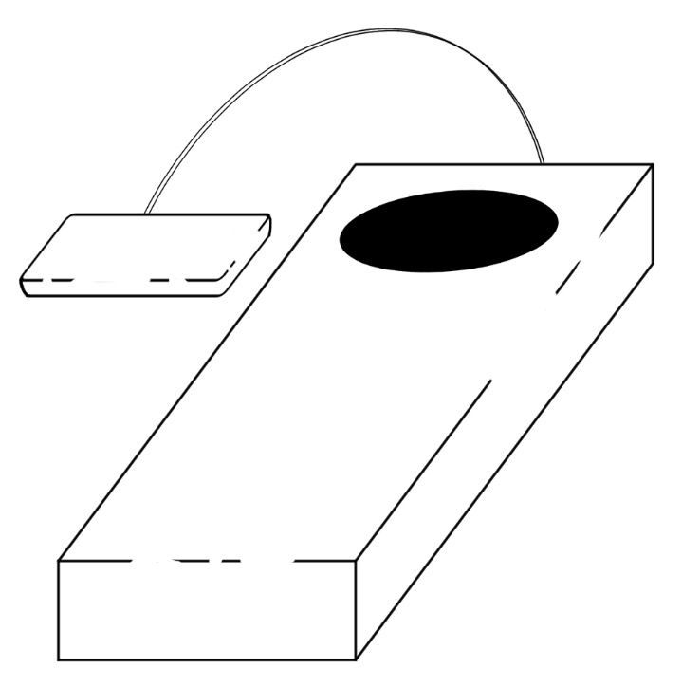
Idea of one of solutions
【The angle sensor ]
Putting between back and backrest
【SIZE】
long：15cm
wide：５cm
hight：2.5cm
【Indicate the value of angle】
Alarm of measured value
Notes:
This is one of the students' ideas.
As a function, there are a sensor part and an angle display part. Based on this idea, we receive feedback from the field, such as ``the size should be a little smaller'' and ``it would be better if the display could be seen visually rather than audibly.''

Slide 12
PCED：Practice in Clinical
Equipment development
The PCED course applies and improves the knowledge gained in the PAD. Bring your ideas to life through functional prototyping.
(1) Enhancing existing designs with industrial design elements while meeting the required functionality.
(2) Understanding and incorporating fail-safe and foolproof principles into the design process.
(3) Building functional prototypes and preparing comprehensive reports documenting the development process.
Notes:
The PCED course applies and improves the knowledge gained in the PAD. Bring your ideas to life through functional prototyping. This course has three goals:
(1) Enhancing existing designs with industrial design elements while meeting the required functionality. (2) Understanding and incorporating fail-safe and foolproof principles into the design process. (3) Building functional prototypes and preparing comprehensive reports documenting the development process.

Slide 13
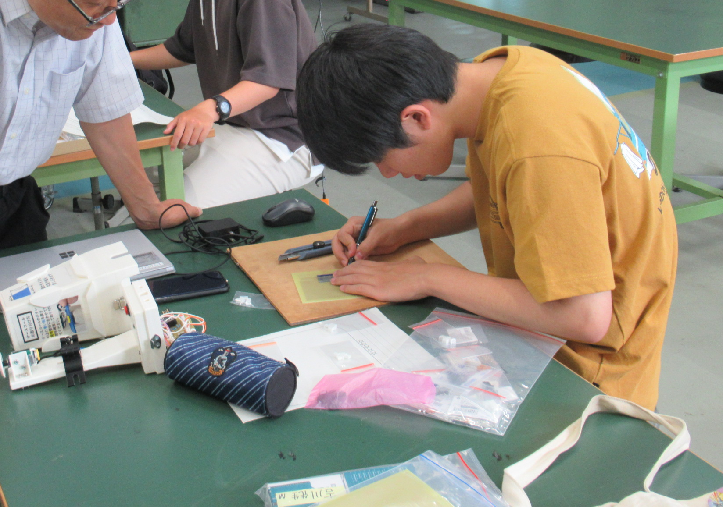
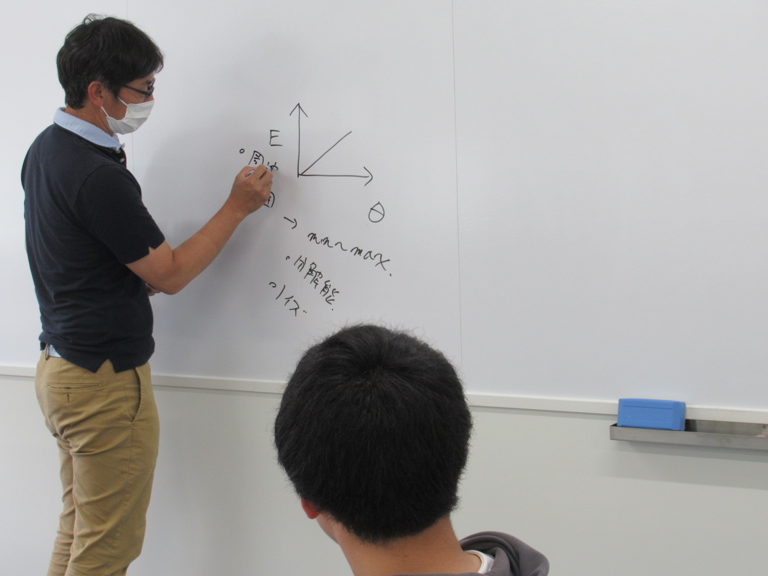

Slide 14
CPAT：Assistive Technology and Co-op
In the CPAT course, the products developed by PCED are used in cooperation with medical institutions, evaluated, and further improved. It is also intended to be re-evaluated and brushed up.
(1) Understanding and applying the experimental planning based on the "Ethical Guidelines for Medical Research Involving Human Subjects" to conduct product evaluations in actual medical settings.
(2) Understanding and utilizing the non-verbal communication effectiveness between the developed products and the clinical environment.
(3) Being able to consider improvements based on evaluations and checks.
Notes:
In the CPAT course, the products developed by PCED are used in cooperation with medical institutions, evaluated, and further improved. It is also intended to be re-evaluated and brushed up. This course has three goals:
(1) Understanding and applying the experimental planning based on the "Ethical Guidelines for Medical Research Involving Human Subjects" to conduct product evaluations in actual medical settings. (2) Understanding and utilizing the non-verbal communication effectiveness between the developed products and the clinical environment.
(3) Being able to consider improvements based on evaluations and checks.

Slide 15
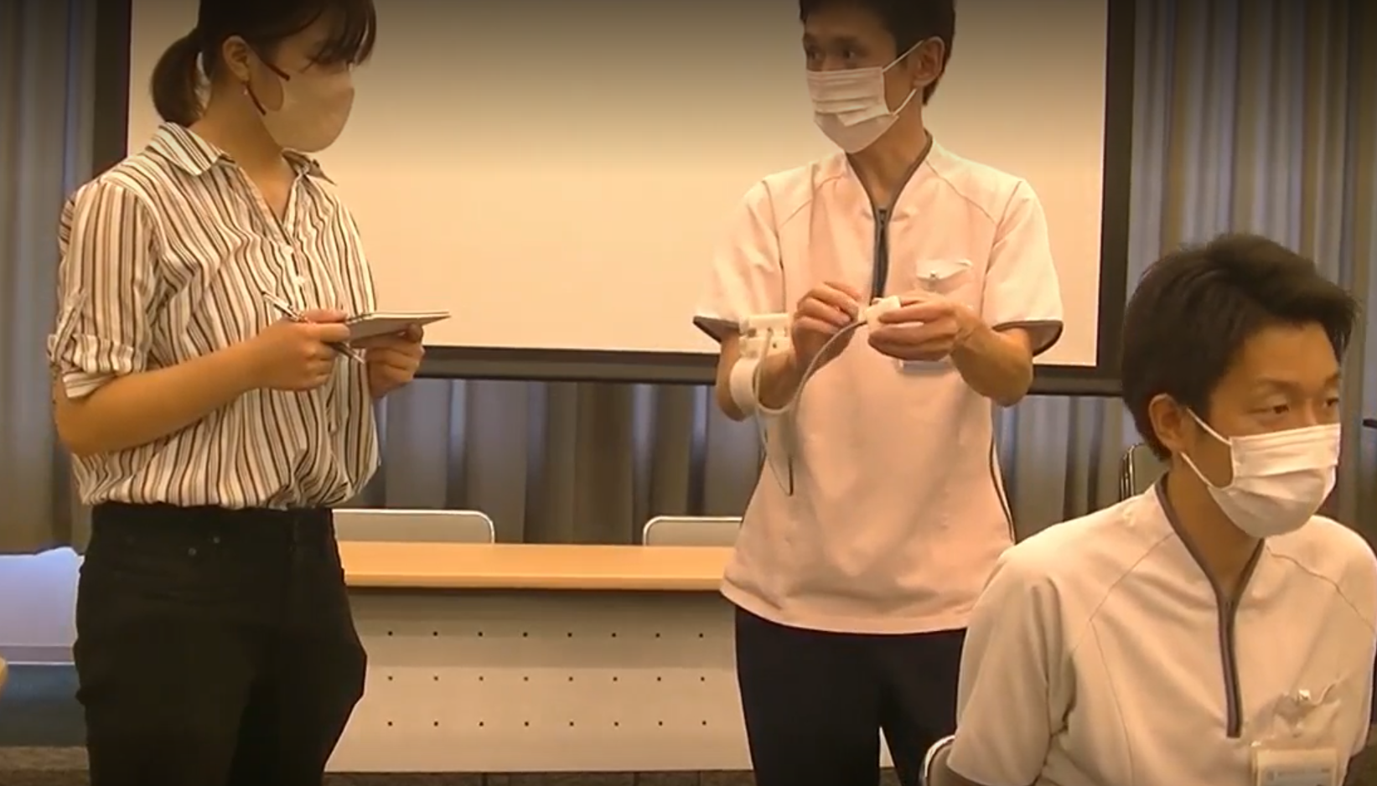
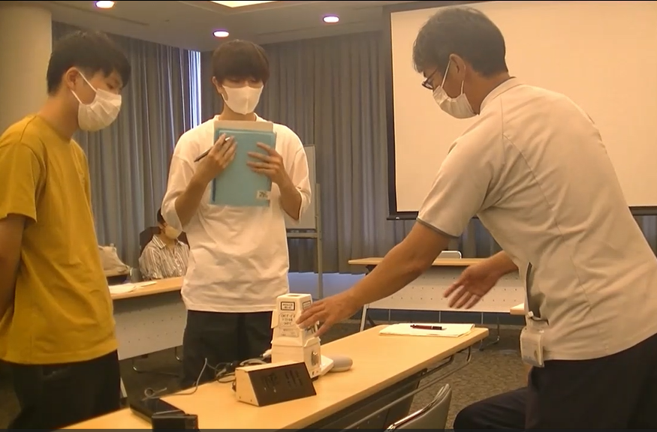
Physical therapists, Occupational therapists and Speech therapists
Notes:
Discussion with physical therapists, occupational therapists, speech therapists, etc.

Slide 16
IMWT：Introduction to Medical Welfare Technology
In the IMWT course, students gain hands-on experience in creating products for clinical settings and learn about the development of project proposals, experimental plans, and other related documents.
(1) Understanding the social security system in Japan.
(2) Understanding the symptoms of diseases such as dementia and recognize the considerations necessary to address related social issues.
(3) Understanding the concept of biofeedback and being able to apply it.
(4) Understanding the specifications and quality assurance in the development of welfare and medical devices and being able to apply them.
Notes:
In the IMWT course, students gain hands-on experience in creating products for clinical settings and learn about the development of project proposals, experimental plans, and other related documents. The course has set the following four objectives.
(1) Understanding and applying the social security system in Japan. (2) Understanding the symptoms of diseases such as dementia and recognize the considerations necessary to address related social issues. (3) Understanding the concept of biofeedback and being able to apply it.
(4) Understanding the specifications and quality assurance in the development of welfare and medical devices and being able to apply them.

Slide 17
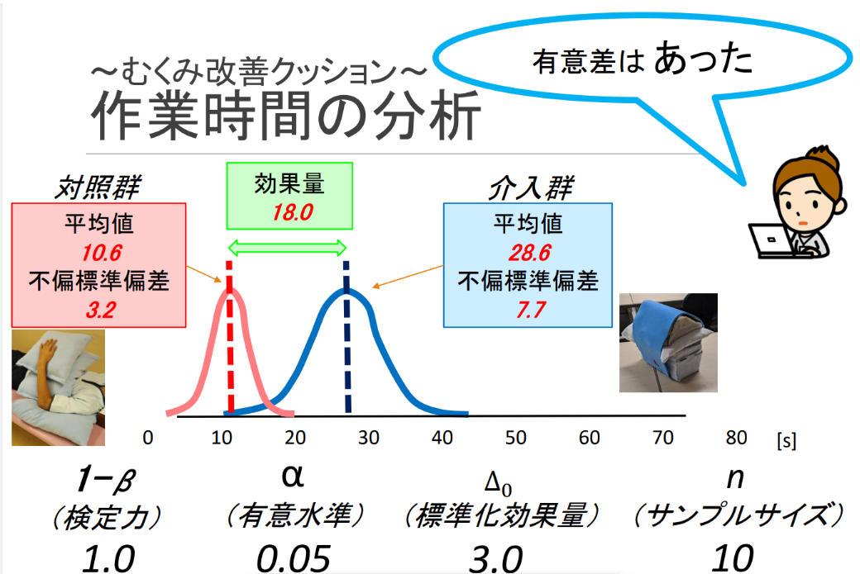
There was a significant
difference
swelling improvement cushion
Work time analysis
control group
Effect size
intervention group
Average value
Average value
unbiased standard deviation
unbiased standard deviation
Verification power
significance level
Standardized effect size
Sample size
Notes:
This figure shows a sample slid of a class in which hospital staff used devices made by students and statistically analyzed the results compared with conventional devices.

Slide 18
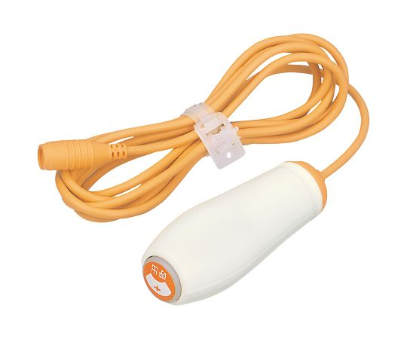
The example of interdisciplinary collaboration in medical engineering product development.
Development of a voice input device
utilizing existing nurse call systems.
However, the content of the paper does not focus on the novelty of the developed functions, but instead discusses what is important for the development of devices that can be used in medical settings.
Notes:
Introducing an example of medical-engineering collaborative manufacturing.
We have developed a voice input device that uses existing nurse calls.
However, the content of the paper does not focus on the novelty of the developed functions, but instead discusses what is important for the development of devices that can be used in medical settings.

Slide 19
Specifications of the design
Utilizing existing hospital nurse call systems
: Hospital administrators‘ requirement.
Allowing individuals with cervical spine injuries (quadriplegia) to operate it using voice commands and also enabling manual use during emergencies, including by family members. :Patients (users/operators)
Ensuring ease of use without the need for explanations.
: Users
Easy installation in any patient room without the need for explanations. : Hospital staff (nurses)
Notes:
Specifications of the design are following :
Utilizing existing hospital nurse call systems : by Hospital administrators‘ requirement.
Allowing individuals with cervical spine injuries (quadriplegia) to operate it using voice commands and also enabling manual use during emergencies, including by family members. :by Patients /users/operators
Ensuring ease of use without the need for explanations. :by Users
Easy installation in any patient room without the need for explanations. : by Hospital staff /nurses
既存の病院内のナースコールを使用すること：病院(経営者）の要求
頸椎損傷(四肢麻痺）者が音声で使用し、家族など緊急時には、手動でも利用できること：患者(利用者・操作者）
説明を受けなくても使い方が理解できること：利用者
どの病室でも、説明なくても簡単に設置できること：病院スタッフ(看護師）

Slide 20
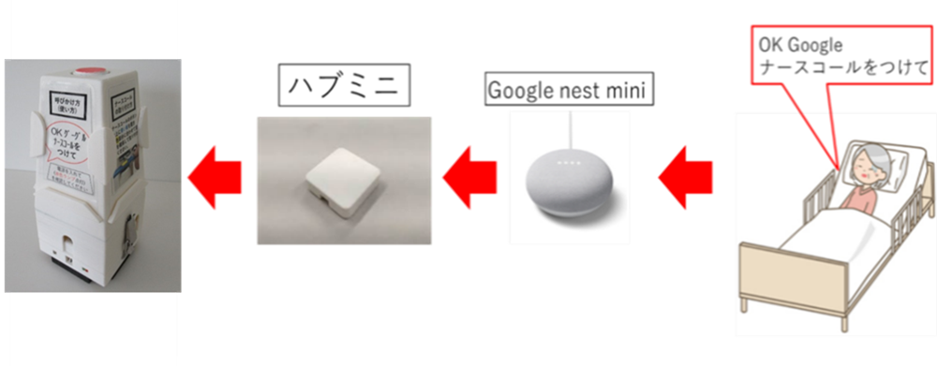
One example of a solution
Call Base
OK Google
Make a nurse call
HUB
Mini
Google nest mini
Notes:
Here is one possible solution.
Using the AI ​​speaker, the existing nurse call can be used by attaching it to the detachable Call-BASE.

Slide 21
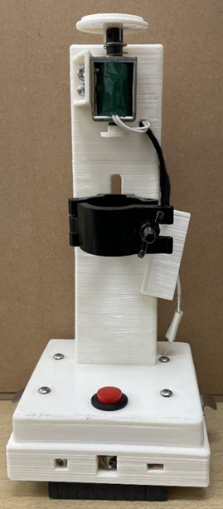
By retrofitting existing nurse call systems and using voice input, we activate an electromagnetic valve (solenoid) to physically press the nurse call button.
Manual pressing of the upper part is also possible to trigger the nurse call.
push button
solenoid
clamp
board
Notes:
This photo shows the inside of Call-base.
Attach the nurse call with a clamp.
With the AI ​​speaker, when the voice switch is turned on, a solenoid is activated to press the nurse call. On the other hand, pressing the Push-button allows you to manually press Nurse Call.

Slide 22
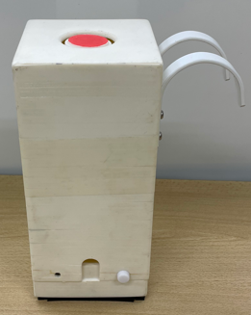
First Call-BASE
At the hospital, it was initially required by the design specifications that the device should be attached to the bed side guard.
However, upon actual fabrication and use, it became evident that changes were necessary.
The bed railings need to be removed for caregiving purposes, and at that point, a decision on where to place the device must be made. This posed a safety risk as it could lead to a search for the nurse call, which is hazardous.
Notes:
This photo is the first prototype. Initially, the hospital required that the device be installed on the bed side guard as a design specification. However, when it was actually produced and used, the following became clear.
As a result, changes were forced.
"Handrails need to be removed for nursing care, and when that happens, we have to decide where to put the equipment. This can lead to a search for a nurse call, which is dangerous."

Slide 23
Improvement
As social implementation education, we will explain the voice nurse call device that students have improved in response to improvement requests from hospitals.
Notes:
As social implementation education, we will explain the voice nurse call device that students have improved in response to improvement requests from hospitals.

Slide 24
Improvement
To address these issues, the following improvements were made.
By placing it on a TV stand, there is no need to move it (for nurses).
To ensure that even if users forget, the operating instructions are prominently displayed on the surface of the device itself (for patients/users).
To facilitate easy installation of the nurse call without the need for explanations, we attached photographs with accompanying instructions directly to the device (for nurses).
Notes:
We will explain the voice nurse call device that the students improved in response to requests for improvements from hospitals.
To address these issues, the following improvements were made.
By placing it on a TV stand, there is no need to move it (for nurses).
To ensure that even if users forget, the operating instructions are prominently displayed on the surface of the device itself (for patients/users).
To facilitate easy installation of the nurse call without the need for explanations, we attached photographs with accompanying instructions directly to the device (for nurses).

Slide 25
Important things
These getting improvement points (feedback) were only revealed once a demo unit, allowing the idea of solution to be tested, became available.
・Even if the design specifications are not clearly defined, it is crucial to materialize ideas quickly.
・ Creating prototypes based on crystallized ideas is essential for uncovering hidden needs.
Notes:
These getting improvement points (feedback) were only revealed once a demo unit, allowing the idea of solution to be tested, became available.
In other words, Even if the design specifications are not clearly defined, it is crucial to materialize ideas quickly. Creating prototypes based on crystallized ideas is essential for uncovering hidden needs.

Slide 26
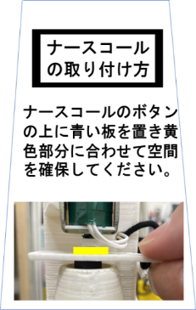
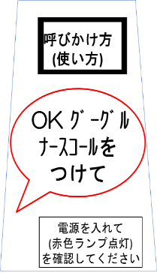
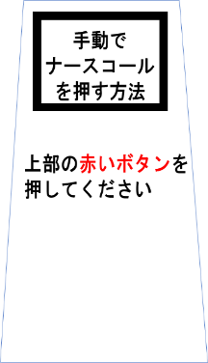
(a) mounting arrangement (b) how to call (c) how to push
Notes:
Figure (a) shows how to install the nurse call. Even with nurse calls of various sizes, it is necessary to secure a space suitable for the movable length of the solenoid and install it.
Figure (ｂ) shows how to nurse call.
Figure (c) how to make a manual nurse call in an emergency, even if you are a family member or someone who only knows the general nurse call.

Slide 27
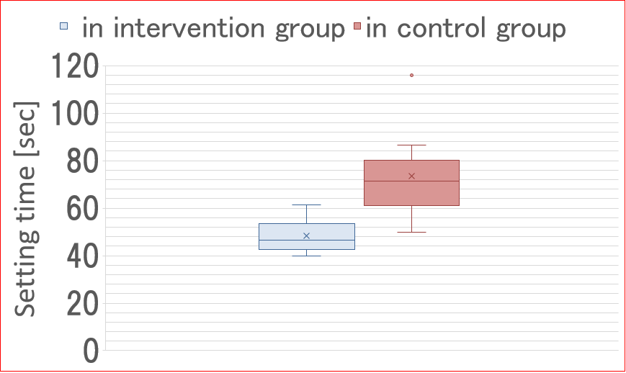
The results of installation time measurement experiments conducted by nurses revealed that this improved device significantly reduces the time required for installation.
*
*: p<0.05
Notes:
After making the above improvements, we conducted an experiment on nurses.
We measured the time it took for non explained nurse to connect an existing nurse call to Call-BASE. The control data was obtained using a pre-improvement device, and the subjects were different.

Slide 28
Things necessary for students with little manufacturing experience
Quantitative evaluation, as opposed to abstract evaluations like 'good' or 'bad,' has revealed that even small improvements by students carry significance.
These evaluations serve as motivation for students in their projects.
Notes:
I think that the following things are necessary for students who have little experience in manufacturing.
Quantitative evaluation, as opposed to abstract evaluations like 'good' or 'bad,' has revealed that even small improvements by students carry significance. These evaluations serve as motivation for students in their projects.

Slide 29
Conclusions
(1) It is important to materialize ideas without spending too much time, even if the design specifications are not initially clear. Creating a prototype based on these materialized ideas is crucial for exploring masked needs.
(2) The focus should be on conducting empirical experiments with the created prototypes rather than solely on the fabrication process (materializing ideas). Evaluating the effectiveness quantitatively through these experiments is essential.
(3) Close coordination between coordinators from the medical and engineering fields, as well as collaboration with healthcare staff in the clinical setting, is crucial. Setting the final goal, which includes establishing quantitative evaluation criteria, is of utmost importance.
Notes:
(1) It is important to materialize ideas without spending too much time, even if the design specifications are not initially clear. Creating a prototype based on these materialized ideas is crucial for exploring masked needs.
(2) The focus should be on conducting empirical experiments with the created prototypes rather than solely on the fabrication process (materializing ideas). Evaluating the effectiveness quantitatively through these experiments is essential.
(3) Close coordination between coordinators from the medical and engineering fields, as well as collaboration with healthcare staff in the clinical setting, is crucial. Setting the final goal, which includes establishing quantitative evaluation criteria, is of utmost importance.

