Slide 1
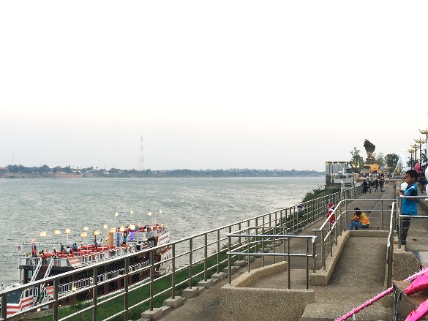
International exchange between Thai and Japanese students as a part of an environmental research project
ISATE2023, 2023-09-13, 09:40– (Asia/Tokyo), Terrsa Hall B
T.Masuzaki^{*,a}, S. Prainetr^{b} , N. Prainetr ^{b}, T., Ito ª T. Makiyama ª and G. DAVAA ª
ª National Institute of Technology (KOSEN), Yuge College, Ehime, Japan
^{b} Nakhon Phanom University, Nakhon Phanom, Thailand
16th International Symposium on Advances in Technology Education 12-15 September 2023, Matsue City, Japan

Slide 2
Outline
Introduction
Feature of Our schools
Interacted departments
Past exchange results
Schedule of Our Project
Mekong River
Our developments
  Environmental research boat
  Nursing Equipment
  Water-quality survey
Cultural exchange
Results
Conclusions

Slide 3
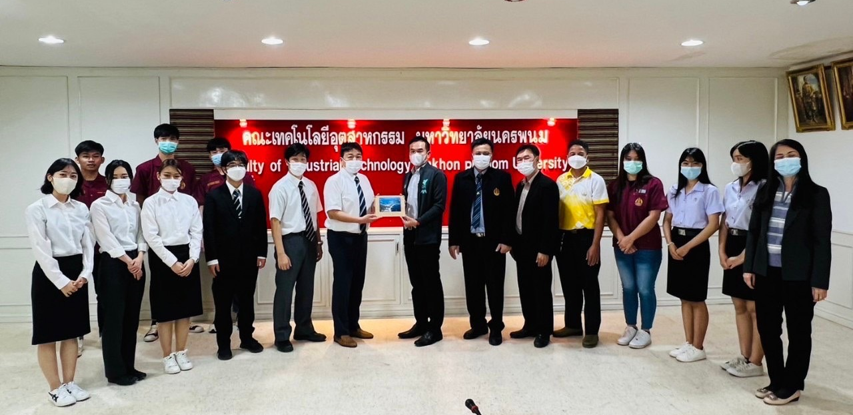
Introduction
National Institute of Technology(KOSEN), Yuge College and Nakhon Phanom University (NPU) are international exchange partner schools, and regularly conduct short-term study abroad programs.
Purpose
We educate international engineers through collaborative research on Mekong River.

Slide 4
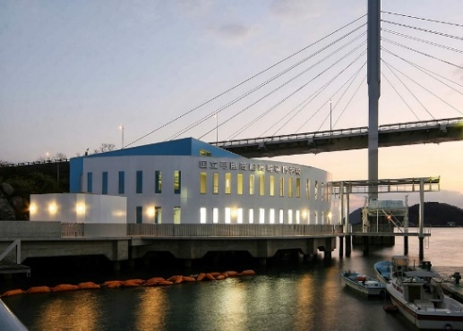
Features of our schools
Both schools are facing the waterside.
Various studies are being conducted to take advantage of these locations.
Yuge in Japan
Nakhon Phanom in Thailand

Slide 5

Interacted departments
Yuge students in Japan
NPU students in Thailand
Electronic Mechanical Engineering
Information Technology
Electronic Engineering
Nursing

Slide 6
Past exchange results
We have exchanged 5 times from 2012.
Implementation Year | Number of students | Major Developments
2012 | 7 | Environmental Research Boat
2014 | 7 | Environmental Research Boat
2016 | 4 | Nursing Equipment
2019 | 6 | Nursing Equipment
2022 | 4 | Water-quality survey

Slide 7
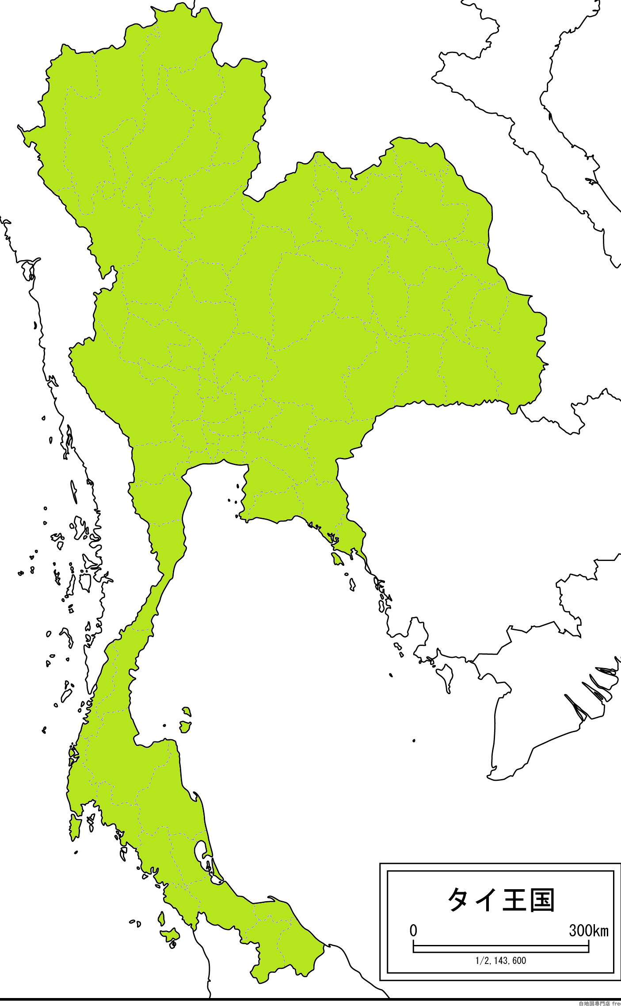
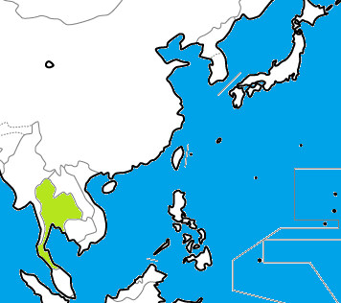
Nakhon
Phanom
Hukuoka
Bangkok

Slide 8
Schedule of Our Project (2022)
Date | Activities
18th Dec. | Transfer (Hukuoka → Bangkok →Nakhon Phanom)
19th - 24th Dec. | Project, Cultural exchange
25th Dec. | Transfer (Nakhon Phanom → Bangkok)
26th Dec. | Free activities in Bangkok
27th - 28th Dec. | Transfer (Bangkok → Hukuoka)

Slide 9
Mekong River
The Mekong River flows through the borders of Thailand, Laos, Vietnam, and others.
The environment of the river has been changing due to construction works in upstream.
Our project has been developing an observation and “environmental research boat” for the Mekong River.
Thailand

Slide 10
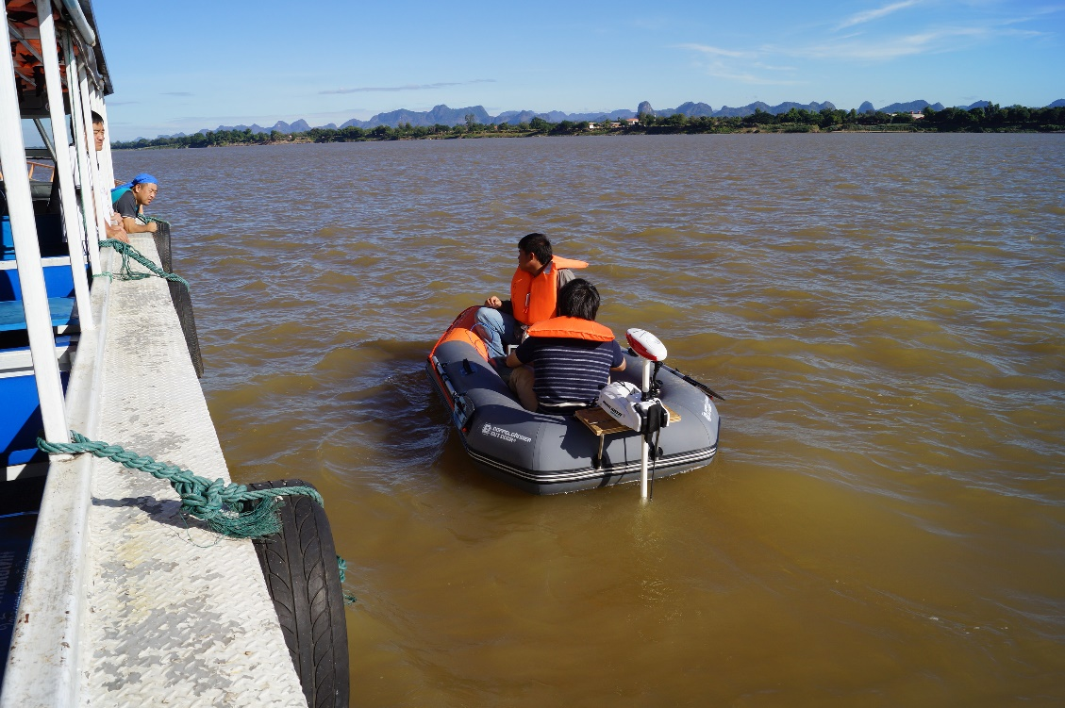
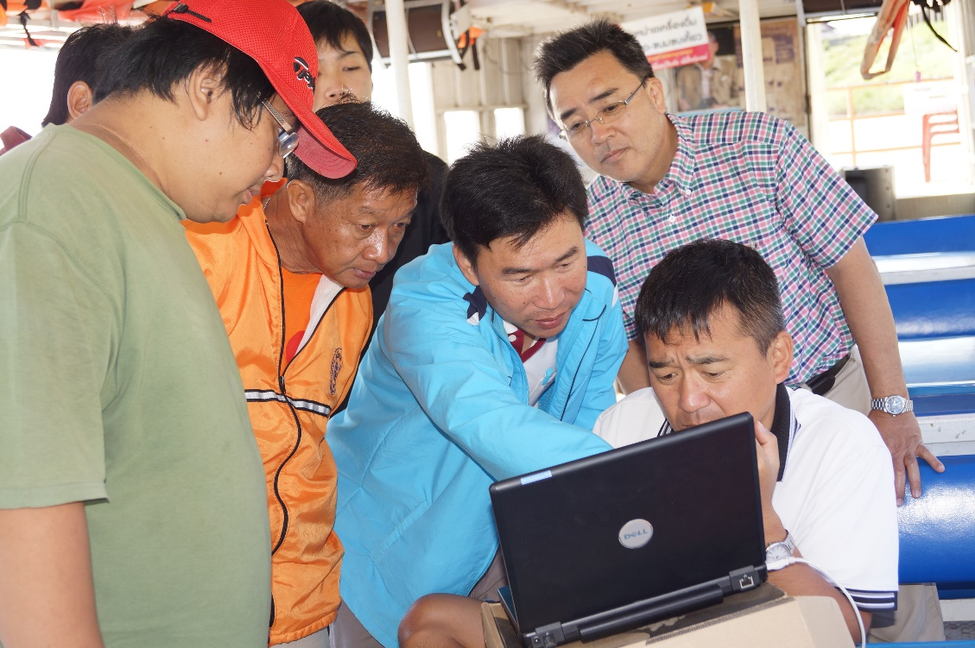
Development of environmental research boat
Teachers and students from Yuge college and NPU are collaborating to develop an auto-navigating environmental research boat. The environmental research boat was used to conduct a river bottom survey of the Mekong River.

Slide 11
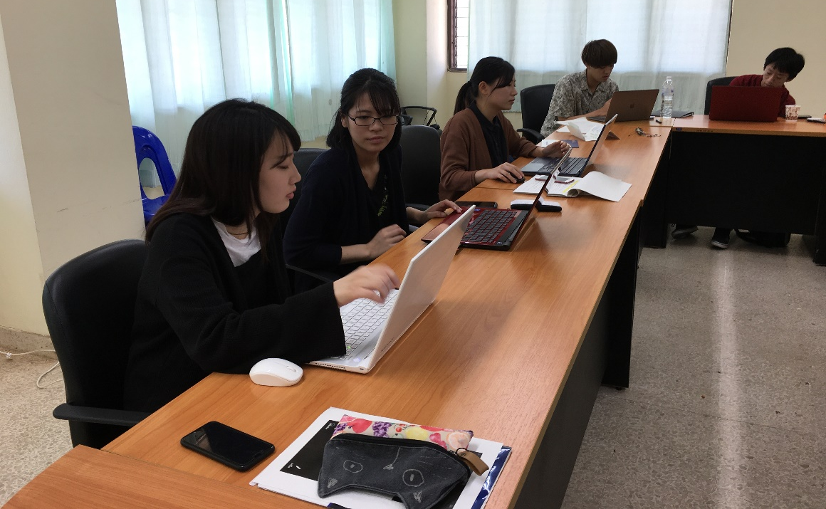
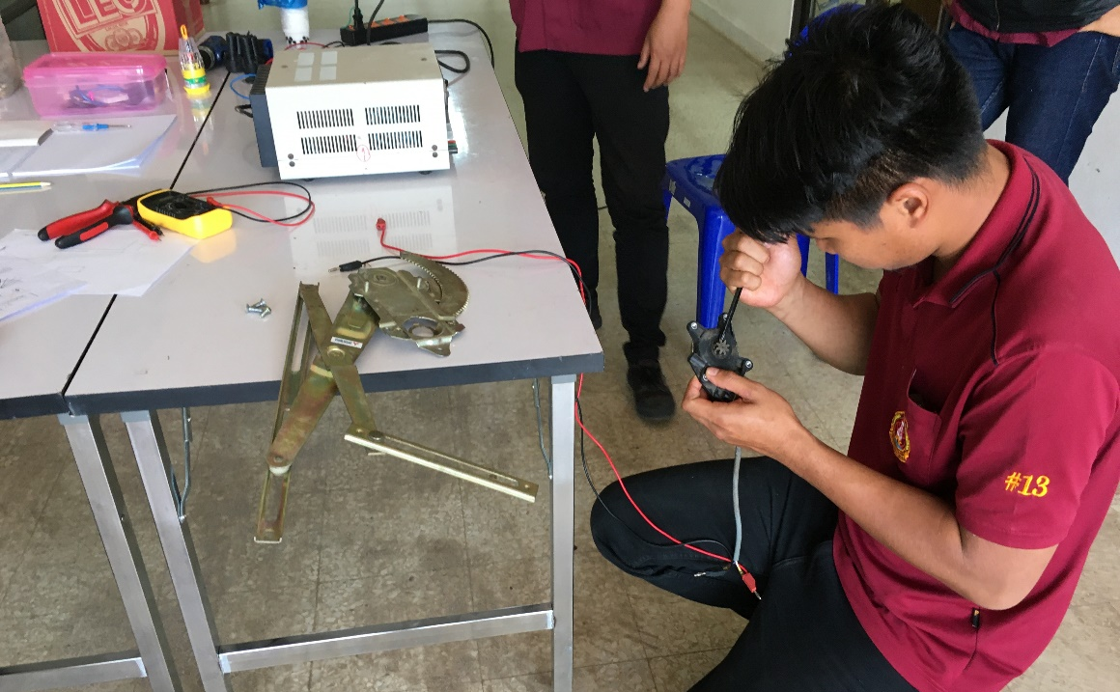
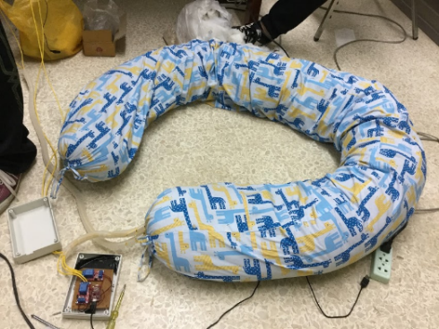
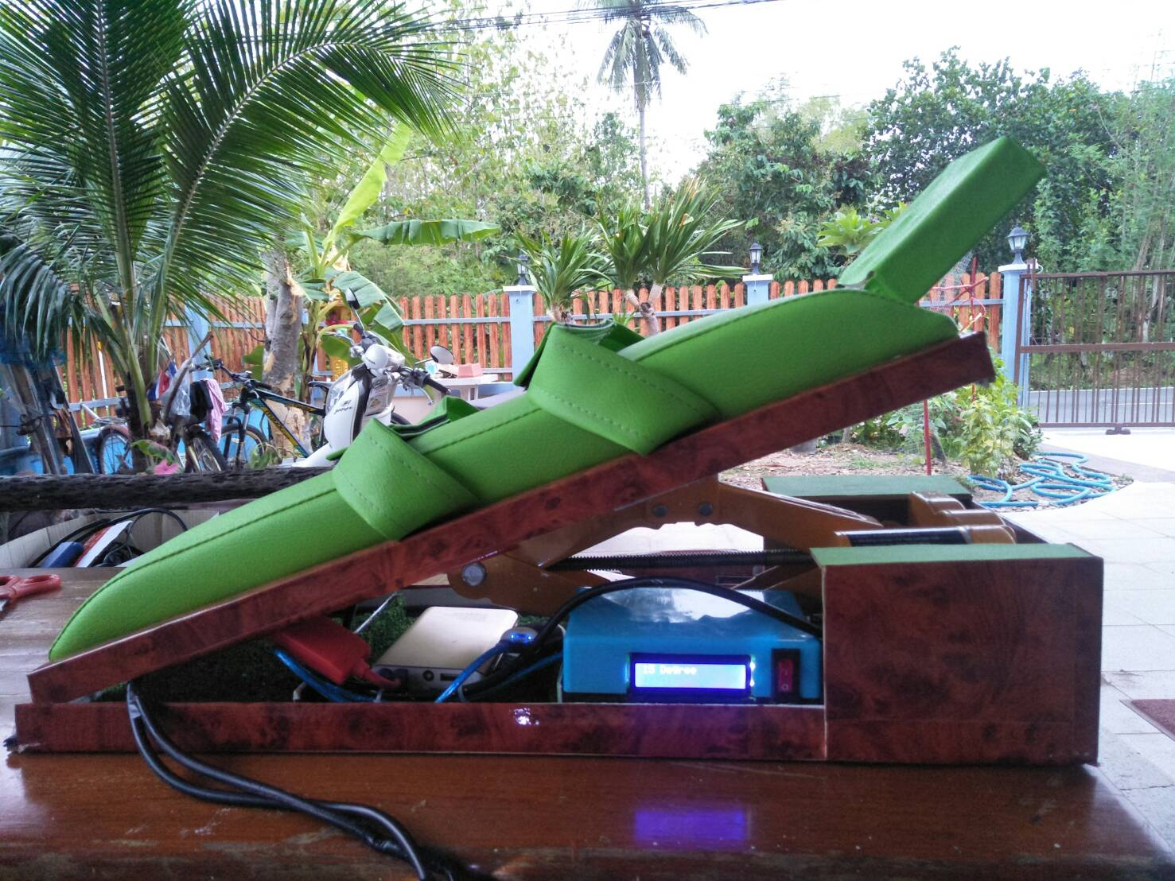
Development of Nursing Equipment
We developed a massage pillow for pregnant women and an equipment for foot injuries.
Engineering students developed both the hardware and software for the tasks proposed by the nursing students.
Maternity pillow(2016)
Equipment for foot injuries(2019)

Slide 12
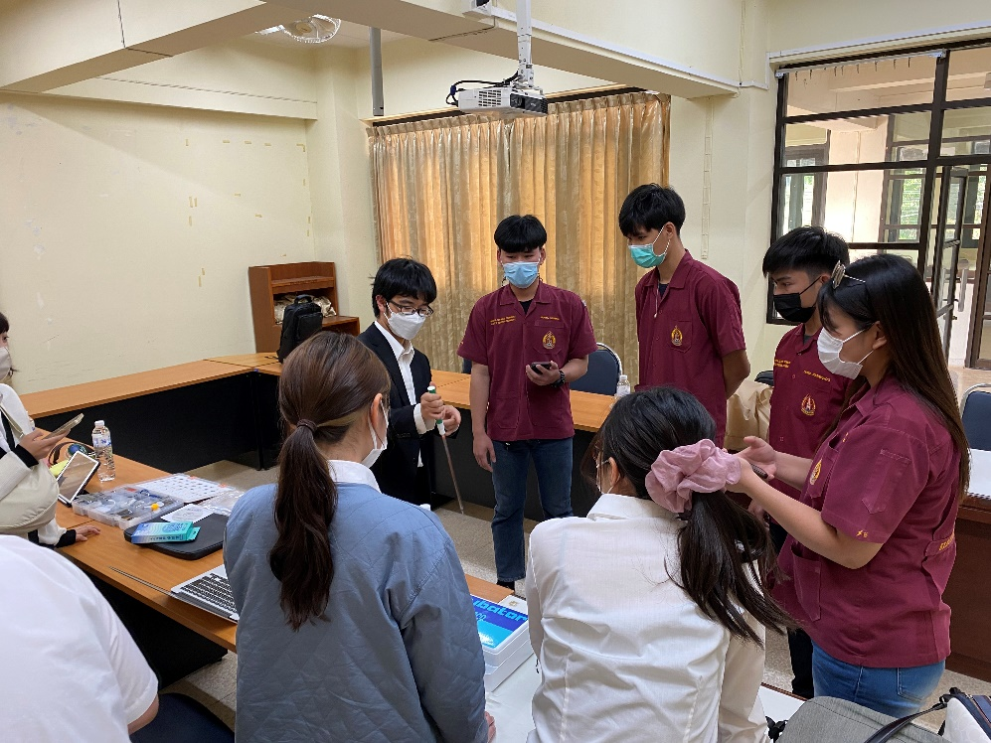
Our latest project in 2022
The students were asked to discuss and develop their own water quality survey system and research on the Mekong River.
Activities in our project
Introduction to Each School
Discussion on the System
Development of the Water Supply and Survey System
Water Quality Survey in the Mekong River
Summary and Presentation of Results
Discussion on the System

Slide 13
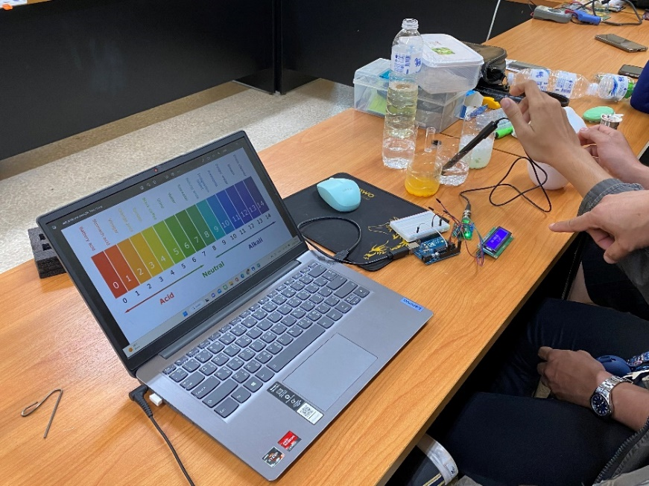
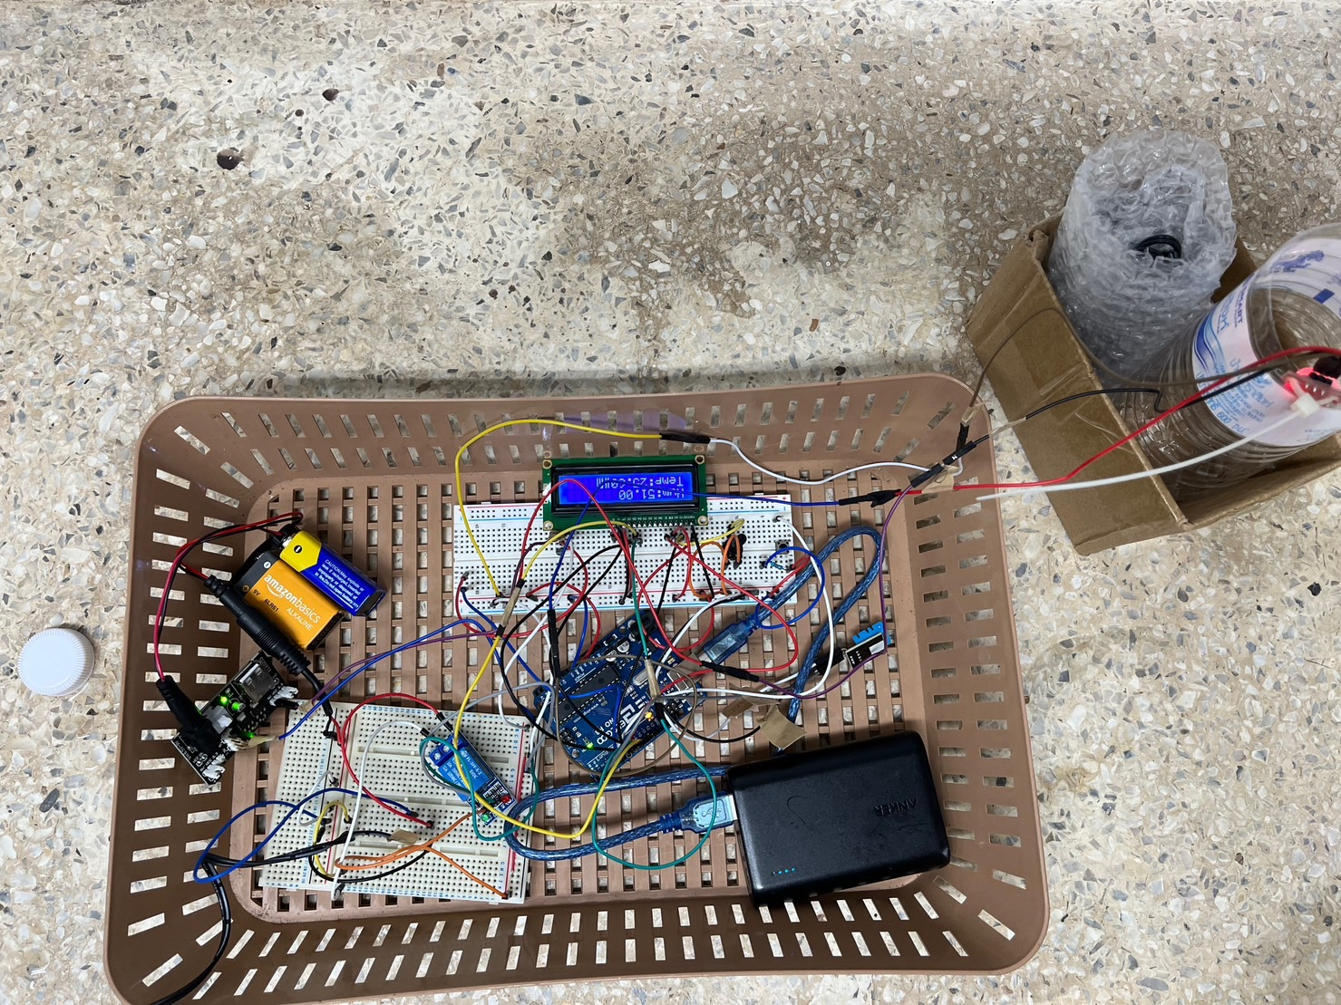
Developments
Students developed the device using English, gestures, and communication through a smartphone app.
Students developed two systems using a microcomputers (Arduino) .
pH Survey System
Water Supply System
pH Survey System
Water Supply System

Slide 14
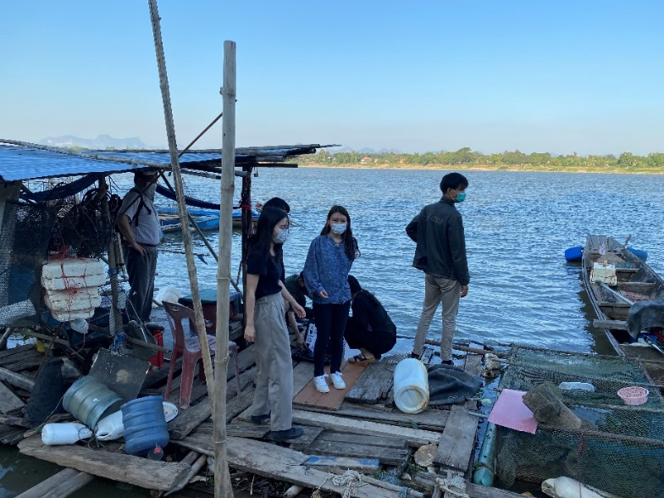
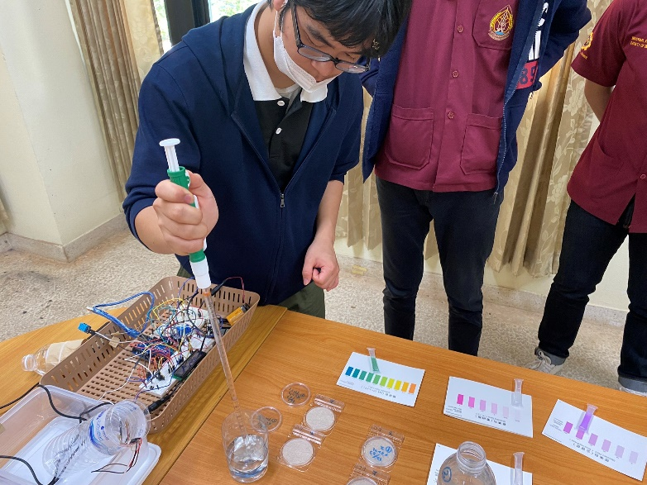
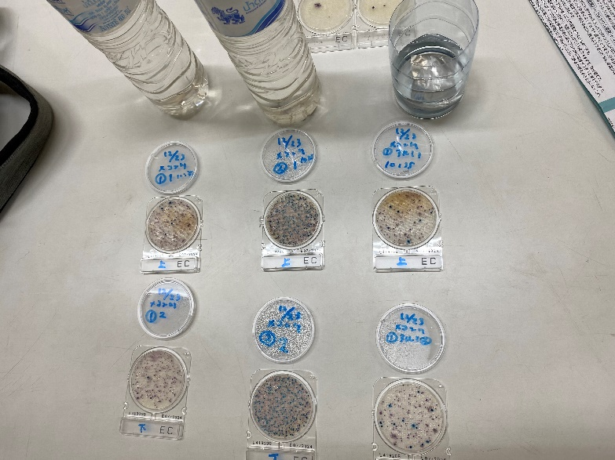
Water Quality Experiment
We sampled water from the Mekong River and studied its quality using analog methods and the system we developed.
The items investigated were pH, chemical Oxygen Demand, Iron, Total Hardness, Nitrite, and E. coli.
Mekong River Water Sampling
Water-Quality Survey

Slide 15
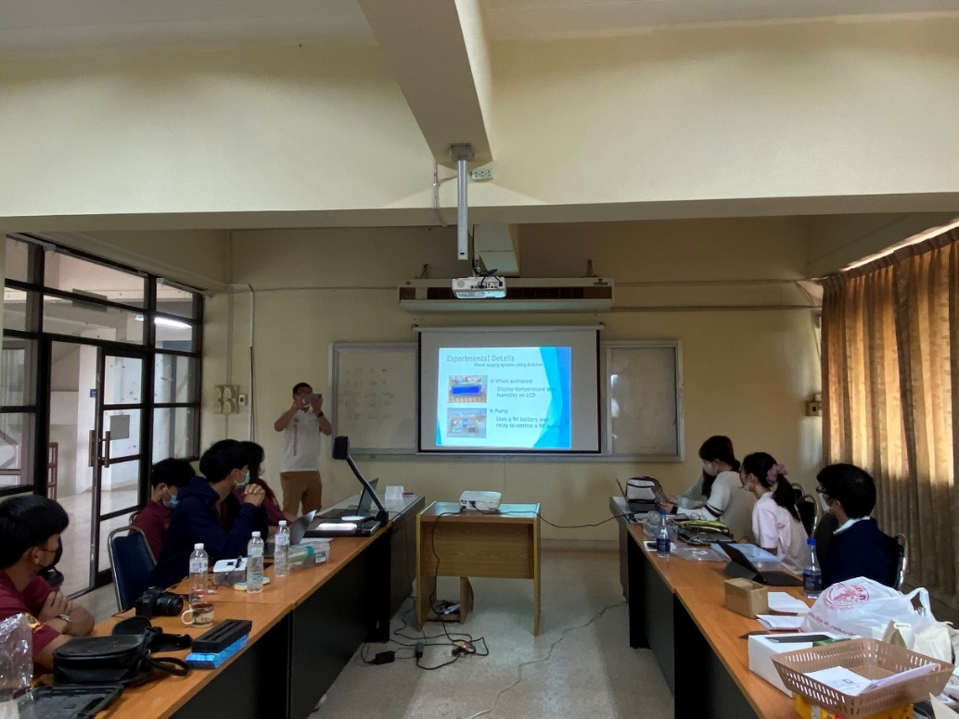
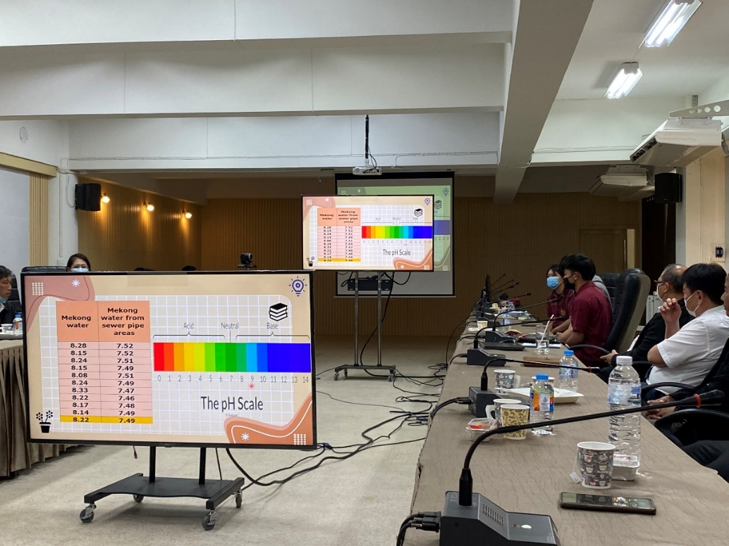
Presentation of Results
The students summarized the project results and first presented them to each other. Then they also presented to the teachers at NPU.
Presentation among students
Presentation to NPU teachers

Slide 16
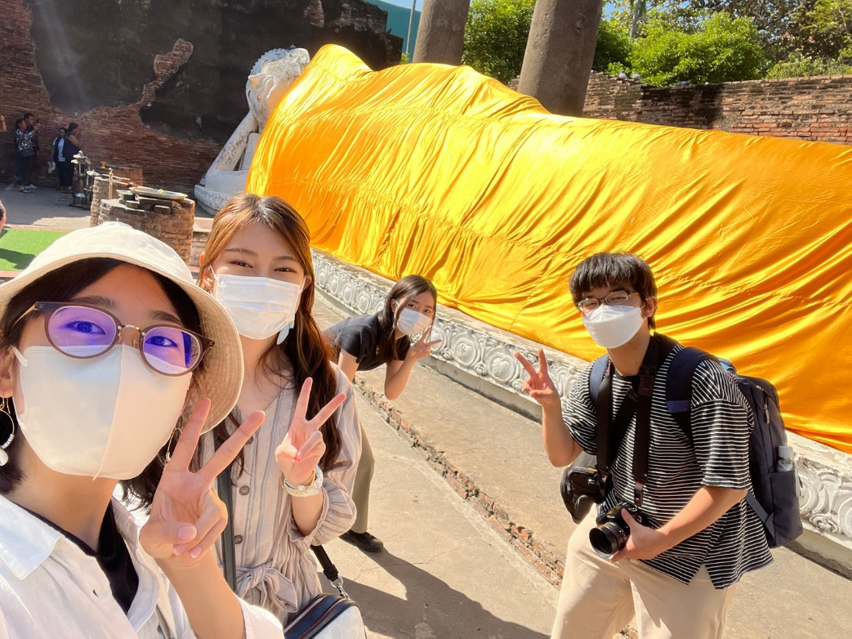
Cultural Exchange
We toured NPU’s facilities and ate Thai food with NPU students.
We also visited temples and historical sites in Thailand.

Slide 17
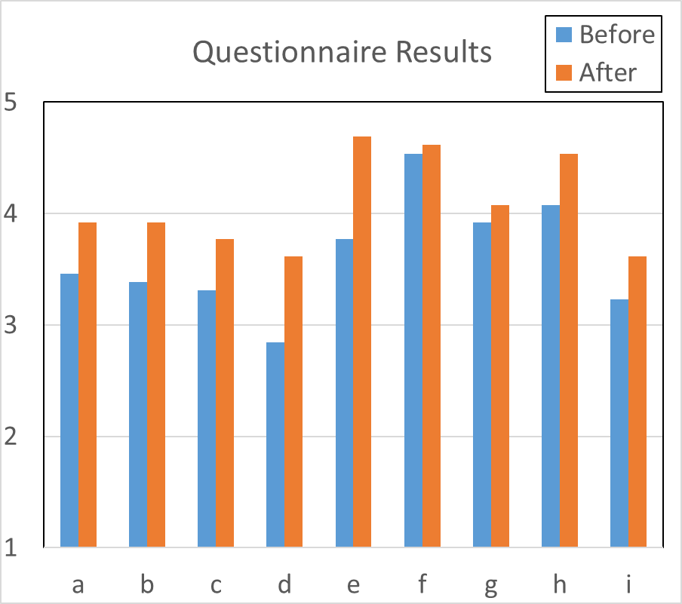
Questionnaire results
Able to take the initiative in finding issues that need to be addressed
Able to reach out to peers and take action to improve problems together
Think about the solution process for an issue and execute it in a planned manner
Able to take a leadership role in different places and within one's own cultural background
Able to actively communicate the meaning of a foreign language, even if it is inadequate
Understand and accept people who have different faiths and cultural backgrounds from their own
Have a strong motivation to study their area of expertise
There is motivation to study linguistics
Have a clear idea of the future direction and career path

Slide 18
This projects were supported by the Japan Student Services Organization (JASSO) Student Exchange Support Program and Yuge College Fund for Advancement of Science and Technology.
This project was made possible through the generous cooperation of Nakhon Phanom University.

Slide 19
Conclusion
We summarize the results of Yuge College and NPU's short-term study .
  Development of environmental research boat and water-quality survey system.
  Cultural exchange
Both Thai and Japanese students were able to understand the culture of their respective countries and gain motivation to become international engineers who can apply the skills they have learned.

